Slide 1
Computational EM Overview
Steven G. Johnson
MIT course 18.369/8.315
Spring 2018

Slide 2
first, some perspective…

Slide 3
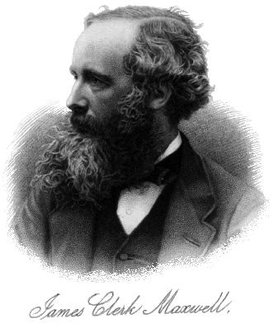
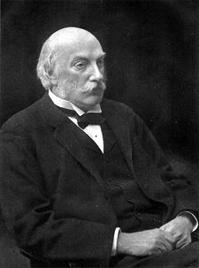
Development of Classical EM Computations
1
Analytical solutions
vacuum, single/double interfaces
various electrostatic problems, …
scattering from small particles,
periodic multilayers (Bragg mirrors), …
… & other problems with
very high symmetry
and/or separability
and/or small parameters
Lord Rayleigh

Slide 4
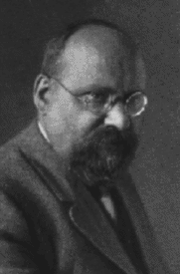
Development of Classical EM Computations
1
Analytical solutions
2
Semi-analytical solutions: series expansions
e.g. Mie scattering of light by a sphere
Also called spectral methods:
Expand solution in rapidly converging Fourier-like basis
• spectral integral-equation methods:
exactly solve homogeneous regions (Green’s func.),
& match boundary conditions via spectral basis
(e.g. Fourier series, spherical harmonics)
• spectral PDE methods:
spectral basis for unknowns in inhomogeous space
(e.g. Fourier series, Chebyshev polynomials, …)
& plug into PDE and solve for coefficients
Gustav Mie
(1908)

Slide 5
Development of Classical EM Computations
1
Analytical solutions
2
Semi-analytical solutions & spectral methods
Expand solution in rapidly converging Fourier-like basis
Strength: can converge exponentially fast
— fast enough for hand calculation
— analytical insights, asymptotics, …
Limitation: fast (“spectral”) convergence requires
basis to be redesigned for each geometry
(to account for any discontinuities/singularities
… complicated for complex geometries!)
(Or: brute-force Fourier series, polynomial convergence)
e.g. Mie scattering of light by a sphere
Gustav Mie
(1908)

Slide 6
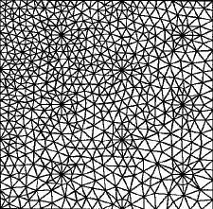
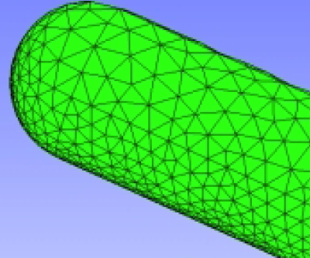
Development of Classical EM Computations
1
Analytical solutions
2
Semi-analytical solutions & spectral methods
3
Brute force: generic grid/mesh (or generic spectral)
PDEs: discretize space into grid/mesh
— simple (low-degree polynomial)
approximations in each pixel/element
integral equations:
— boundary elements mesh
surface unknowns coupled
by Green’s functions
←finite differences
(or Fourier series)
& finite elements→
lose orders of magnitude in performance … but re-usable code
€ computer time << €€€€ programmer time

Slide 7
Computational EM: Three Axes of Comparison
— eigenproblems: harmonic modes ~ e^{–iωt} (J = 0)
— frequency-domain response: E, H from J(x)e^{–iωt}
— time-domain response: E, H from J(x, t)
— PDE or integral equation?
• What problem is solved?
— finite differences (FD)
— finite elements (FEM) / boundary elements (BEM)
— spectral / Fourier
— …
• What discretization?
infinitely many unknowns
⇒ finitely many unknowns
— dense linear solvers (LAPACK)
— sparse-direct methods
— iterative methods
• What solution method?

Slide 8
A few lessons of history
All approaches still in widespread use
brute force methods in 90%+ of papers, typically the first resort to see what happens in a new geometry
geometry-specific spectral methods still popular, especially when particular geometry of special interest
analytical techniques used less to solve new geometries than to prove theorems, treat small perturbations, etc.
No single numerical method has “won” in general
each has strengths and weaknesses, e.g. tradeoff between simplicity/generalizability and performance/scalability
very mature/standardized problems (e.g. capacitance extraction) use increasingly sophisticated methods (e.g. BEM), research fields (e.g. nanophotonics) tend to use simpler methods that are easier to modify (e.g. FDTD)

Slide 9
Computing & Interpreting Band Structures & Dispersion Relations
Steven G. Johnson
MIT Applied Mathematics

Slide 10
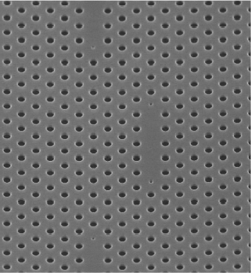
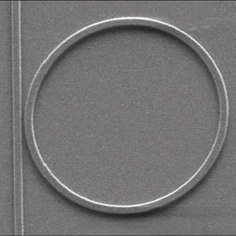
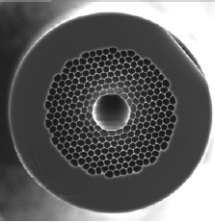
Understanding Photonic Devices
[ Xu & Lipson, 2005 ]
[ Notomi et al. (2005). ]
10µm
20 µm
420 nm
[Mangan, et al.,
OFC 2004 PDP24 ]
Model the whole thing at once? Too hard to understand & design.
Break it up into pieces first: periodic regions, waveguides, cavities

Slide 11
Building Blocks: “Eigenfunctions”
• Want to know what solutions exist in different regions
and how they can interact: look for time-harmonic modes ~ e^{–iωt}
1
First task:
get rid of this mess
0
+ constraint
eigen-operator
(Hermitian for lossless/real ε!)
eigen-value
“eigen-field”

Slide 12
Building Blocks: Periodic Media
homogeneous
media
common thread:
translational
symmetry
waveguides
discrete periodicity: photonic crystals

Slide 13
Periodic Hermitian Eigenproblems
[ G. Floquet, “Sur les équations différentielles linéaries à coefficients périodiques,” Ann. École Norm. Sup. 12, 47–88 (1883). ]
[ F. Bloch, “Über die quantenmechanik der electronen in kristallgittern,” Z. Physik 52, 555–600 (1928). ]
if eigen-operator is periodic, then Bloch-Floquet solutions:
can choose:
planewave
periodic “envelope”
Corollary 1: k is conserved, i.e. no scattering of Bloch wave
Corollary 2: given by finite unit cell,
so ω are discrete ω_{n}(k)

Slide 14
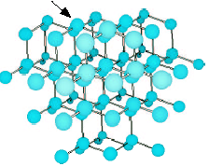
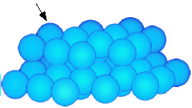
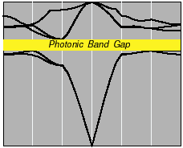
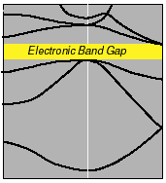
Electronic and Photonic Crystals
atoms in diamond structure
dielectric spheres, diamond lattice
Periodic
Medium
Bloch waves:
Band Diagram
photon frequency
electron energy
wavevector
wavevector
weakly-interacting bosons
… many design degrees of freedom
strongly interacting fermions

Slide 15
Solving the Maxwell Eigenproblem
Finite cell ➔ discrete eigenvalues ω_{n}
Want to solve for ω_{n}(k),
& plot vs. “all” k for “all” n,
constraint:
where field =
H_{n}(x) e^{i(k∙x – ωt)}
1
Limit range of k: irreducible Brillouin zone
2
Limit degrees of freedom: expand H in finite basis
3
Efficiently solve eigenproblem: iterative methods

Slide 16
Solving the Maxwell Eigenproblem: 1
1
Limit range of k: irreducible Brillouin zone
—Bloch’s theorem: solutions are periodic in k
M
k_{y}
first Brillouin zone
= minimum |k| “primitive cell”
Γ
X
k_{x}
irreducible Brillouin zone: reduced by symmetry
2
Limit degrees of freedom: expand H in finite basis
3
Efficiently solve eigenproblem: iterative methods

Slide 17
Solving the Maxwell Eigenproblem: 2a
1
Limit range of k: irreducible Brillouin zone
2
Limit degrees of freedom: expand H in finite basis (N)
solve:
finite matrix problem:
inner product:
Galerkin method:
3
Efficiently solve eigenproblem: iterative methods

Slide 18
Solving the Maxwell Eigenproblem: 2b
1
Limit range of k: irreducible Brillouin zone
2
Limit degrees of freedom: expand H in finite basis
— must satisfy constraint:
Planewave (FFT) basis
Finite-element basis
constraint, boundary conditions:
Nédélec elements
[ Nédélec, Numerische Math.
35, 315 (1980) ]
constraint:
nonuniform mesh,
more arbitrary boundaries,
complex code & mesh, O(N)
uniform “grid,” periodic boundaries,
simple code, O(N log N)
[ figure: Peyrilloux et al.,
J. Lightwave Tech.
21, 536 (2003) ]
3
Efficiently solve eigenproblem: iterative methods

Slide 19
Solving the Maxwell Eigenproblem: 3a
1
Limit range of k: irreducible Brillouin zone
2
Limit degrees of freedom: expand H in finite basis
3
Efficiently solve eigenproblem: iterative methods
Slow way: compute A & B, ask LAPACK for eigenvalues
— requires O(N²) storage, O(N³) time
Faster way:
— start with initial guess eigenvector h₀
— iteratively improve
— O(Np) storage, ~ O(Np²) time for p eigenvectors
(p smallest eigenvalues)

Slide 20
Solving the Maxwell Eigenproblem: 3b
1
Limit range of k: irreducible Brillouin zone
2
Limit degrees of freedom: expand H in finite basis
3
Efficiently solve eigenproblem: iterative methods
Many iterative methods:
— Arnoldi, Lanczos, Davidson, Jacobi-Davidson, …,
Rayleigh-quotient minimization

Slide 21
Solving the Maxwell Eigenproblem: 3c
1
Limit range of k: irreducible Brillouin zone
2
Limit degrees of freedom: expand H in finite basis
3
Efficiently solve eigenproblem: iterative methods
Many iterative methods:
— Arnoldi, Lanczos, Davidson, Jacobi-Davidson, …,
Rayleigh-quotient minimization
for Hermitian matrices, smallest eigenvalue ω₀ minimizes:
variational
/ min–max
theorem
minimize by preconditioned
conjugate-gradient (or…)

Slide 22
Band Diagram of 2d Model System (radius 0.2a rods, ε=12)
a
frequency ω (2πc/a) = a / λ
irreducible Brillouin zone
Γ
X
M
Γ
M
E
gap for
n > ~1.75:1
X
TM
Γ
H

Slide 23
The Iteration Scheme is Important
(minimizing function of 10⁴–10⁸+ variables!)
Steepest-descent: minimize (h + α ∇f) over α … repeat
Conjugate-gradient: minimize (h + α d)
— d is ∇f + (stuff): conjugate to previous search dirs
Preconditioned steepest descent: minimize (h + α d)
— d = (approximate A⁻¹) ∇f ~ Newton’s method
Preconditioned conjugate-gradient: minimize (h + α d)
— d is (approximate A⁻¹) [∇f + (stuff)]

Slide 24
The Iteration Scheme is Important
(minimizing function of ~40,000 variables)
no preconditioning
% error
preconditioned
conjugate-gradient
no conjugate-gradient
# iterations

Slide 25
The Boundary Conditions are Tricky
E|| is continuous
E⊥ is discontinuous
(D⊥ = εE⊥ is continuous)
ε?
Use a tensor ε:
E||
[ Meade et al. (1993) ]
E⊥

Slide 26
The ε-averaging is Important
correct averaging
changes order
of convergence
from ∆x to ∆x²
backwards averaging
% error
no averaging
reason in a nutshell:
averaging
= smoothing ε
= changing structure
… must pick smoothing
with zero 1st-order
perturbation
[ Farjadpour et al. (2006) ]
tensor averaging
resolution (pixels/period)

Slide 27
Closely related to anisotropic metamaterial, e.g. multilayer film in large-λ limit
key to anisotropy is differing
continuity conditions on E:
E|| continuous ⇒ ε|| = <ε>
D⊥=εE⊥ continuous ⇒ ε⊥ = <ε^{–1}>^{–1}
a
λ >> a

Slide 28
Intentional “defects” are good
microcavities
waveguides (“wires”)

Slide 29
Intentional “defects” in 2d
(Same computation, with supercell = many primitive cells)
(boundary conditions ~ irrelevant
for exponentially localized modes)

Slide 30
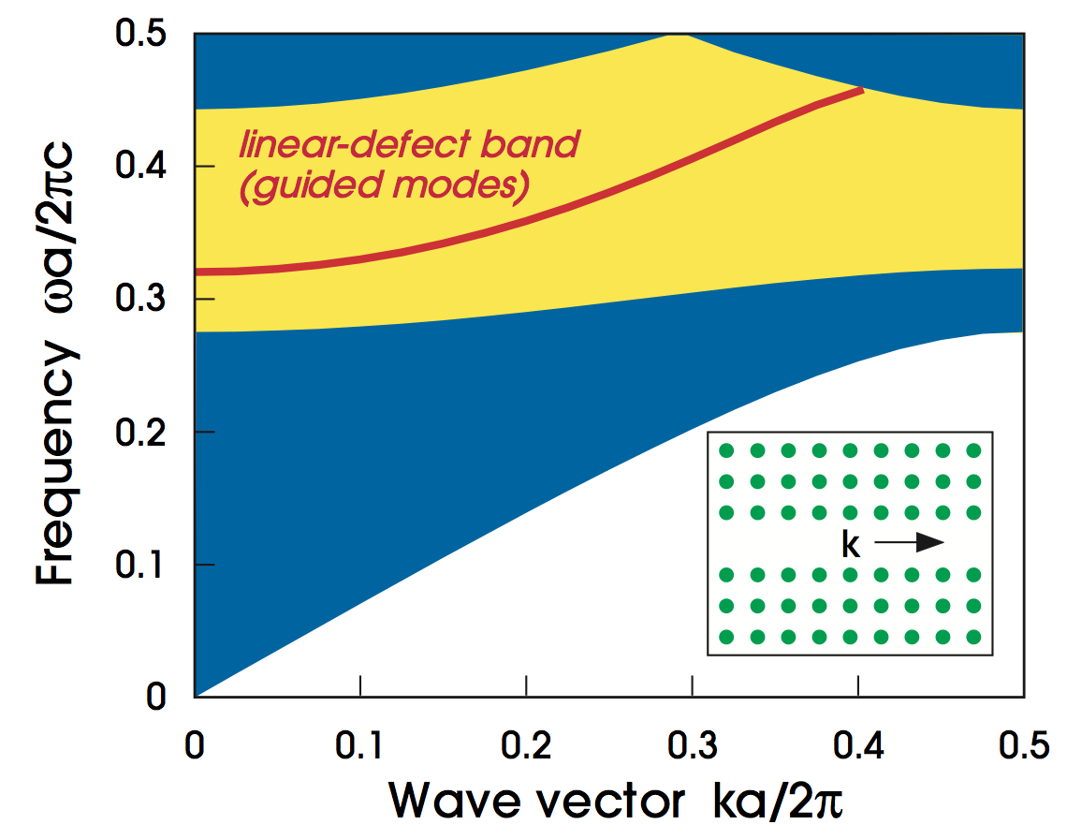
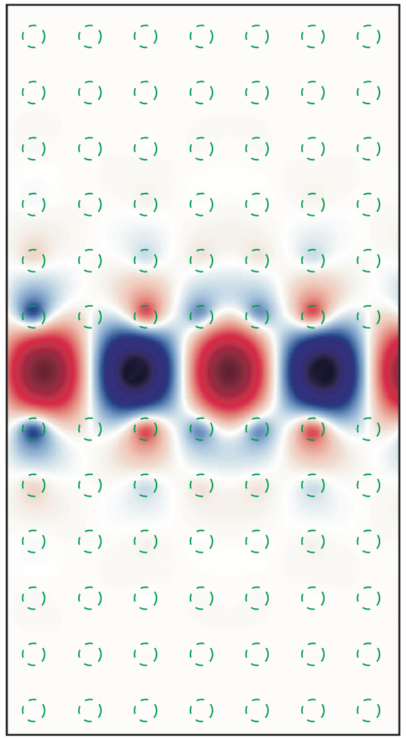
Air-waveguide Band Diagram
projection of bulk-crystal
band diagram
any state in the gap cannot couple to bulk crystal –> localized

Slide 31
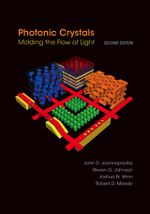
to be continued…
Further reading:
Photonic Crystals book: http://jdj.mit.edu/book
Bloch-mode eigensolver: http://jdj.mit.edu/mpb

Slide 32
Computational Nanophotonics: Cavities and Resonant Devices
Steven G. Johnson
MIT Applied Mathematics

Slide 33
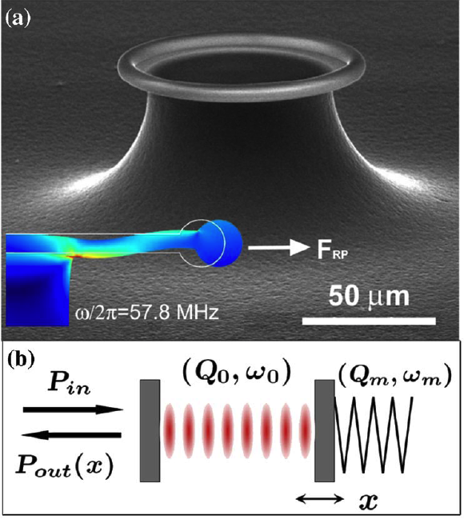
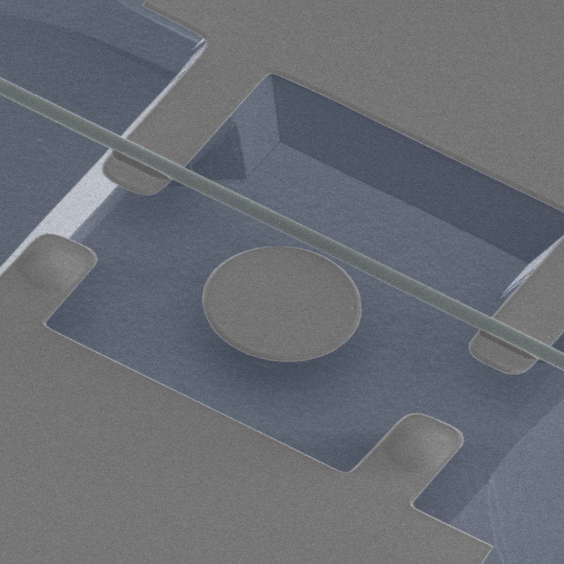
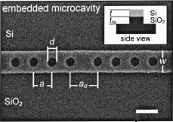
Resonance
an oscillating mode trapped for a long time in some volume
(of light, sound, …)
frequency ω₀
lifetime τ >> 2π/ω₀
quality factor Q = ω₀τ/2
energy in cavity ~ e^{–ω0t/Q}
modal
volume V
[ Notomi et al. (2005). ]
[ C.-W. Wong,
APL 84, 1242 (2004). ]
[ Schliesser et al.,
PRL 97, 243905 (2006) ]
420 nm
[ Eichenfield et al. Nature Photonics 1, 416 (2007) ]

Slide 34
Resonance = Pole in Green’s Function
an oscillating mode trapped for a long time in some volume
(of light, sound, …)
frequency ω₀
lifetime τ >> 2π/ω₀
quality factor Q = ω₀τ/2
energy in cavity ~ e^{–ω0t/Q}
modal
volume V
~ volume where
residue is large
Im ω
near ω₀, Green’s function is dominated by
contribution of the pole ~ a “resonant mode” profile
Re ω
×
simple pole
at ω₀ – i/τ
response to a narrowband pulse
~ exponential decay in time
(in vicinity of the cavity)

Slide 35
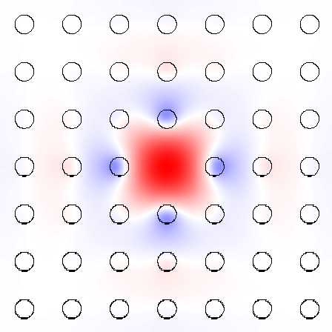
Microcavity Blues
For cavities (point defects)
frequency-domain has its drawbacks:
• Best methods compute lowest-ω eigenvals,
but N^{d} supercells have N^{d} modes
below the cavity mode — expensive
• Best methods are for Hermitian operators,
but losses requires non-Hermitian

Slide 36
Time-Domain Eigensolvers (finite-difference time-domain = FDTD)
Simulate Maxwell’s equations on a discrete grid,
+ absorbing boundaries (leakage loss)
• Excite with broad-spectrum dipole ( ) source
Δω
tricky
signal processing
Response is many
sharp peaks,
one peak per mode
complex ω_{n}
[ Mandelshtam,
J. Chem. Phys. 107, 6756 (1997) ]
decay rate in time gives loss

Slide 37
FDTD: finite difference time domain
Finite-difference-time-domain (FDTD) is a method to model Maxwell’s equations on a discrete time & space grid using finite centered differences
E
H
z
x
K.S. Yee 1966
H
y
E
A. Taflove & S.C. Hagness 2005
y
E
x
H
z

Slide 38
FDTD: Yee leapfrog algorithm
2d example:
at time t: Update D fields everywhere
using spatial derivatives of H, then find E=ε⁻¹D
E_{y}
H_{z}
E_{x} +=
∆t
ε ∆y
( H_{z}^{j+0.5}
– H_{z}^{j-0.5} )
E_{x}
E_{y} -=
∆t
ε ∆x
( H_{z}^{i+0.5}
– H_{z}^{i-0.5} )
2) at time t+0.5: Update H fields everywhere using spatial derivatives of E
E_{y}
H_{z}
H_{z} +=
∆t
μ
( E_{x}^{j+1}
– E_{x}^{j}
+ E_{y}^{i}
– E_{y}^{i+1})
∆y
∆x
E_{x}
CFL/Von Neumann stability: cΔt < 1 / √Δx^{–2}+Δy^{–2}

Slide 39
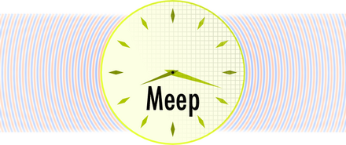
Free software: MEEP
http://ab-initio.mit.edu/meep
• FDTD Maxwell solver: 1d/2d/3d/cylindrical
• Parallel, scriptable, integrated optimization, signal processing
• Arbitrary geometries, anisotropy, dispersion, nonlinearity
• Bloch-periodic boundaries, symmetry boundary conditions,
+ PML absorbing boundary layers…

Slide 40
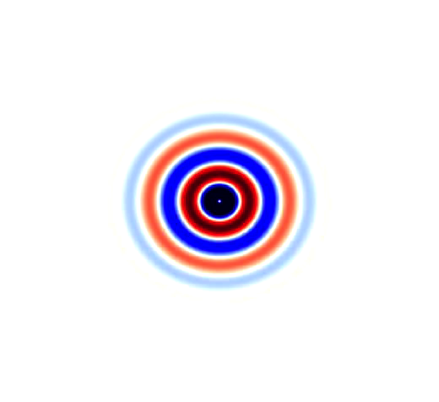
Absorbing boundaries?
Finite-difference/finite-element volume discretizations
need to artificially truncate space for a computer simulation.
In a wave equation,
a hard-wall truncation
gives reflection artifacts.
An old goal: “absorbing boundary condition” (ABC) that absorbs outgoing waves.
Problem: good ABCs are hard to find in > 1d.

Slide 41
Perfectly Matched Layers (PMLs)
Bérenger, 1994: design an artificial absorbing layer
that is analytically reflectionless
Works remarkably well.
Now ubiquitous in FD/FEM
wave-equation solvers.
Several derivations, cleanest
& most general via “complex
coordinate stretching”
[ Chew & Weedon (1994) ]

Slide 42
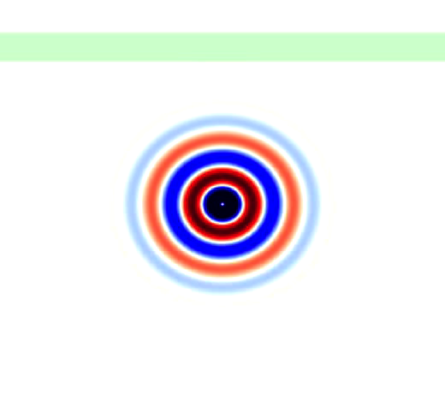
Perfectly Matched Layers (PMLs)
Bérenger, 1994: design an artificial absorbing layer
that is analytically reflectionless
Even works in inhomogeneous
media (e.g. waveguides).

Slide 43
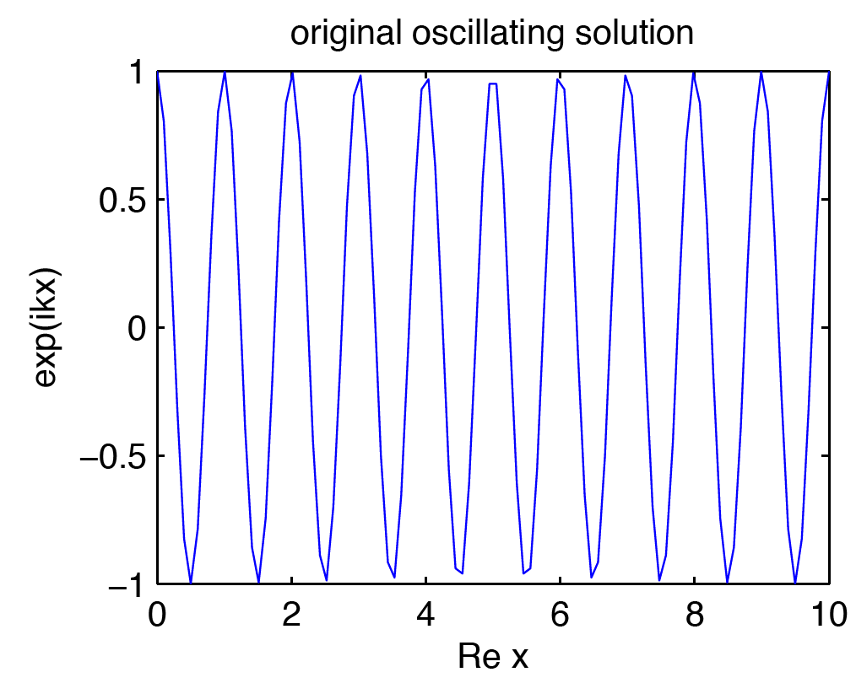
PML Starting point: propagating wave
• Say we want to absorb wave traveling in +x direction
in an x-invariant medium at a frequency ω > 0.
(usually, k > 0)
[ rare “backward-wave”
cases defeat PML
(Loh, 2009) ]
(only x in wave
equation is via
terms.)

Slide 44
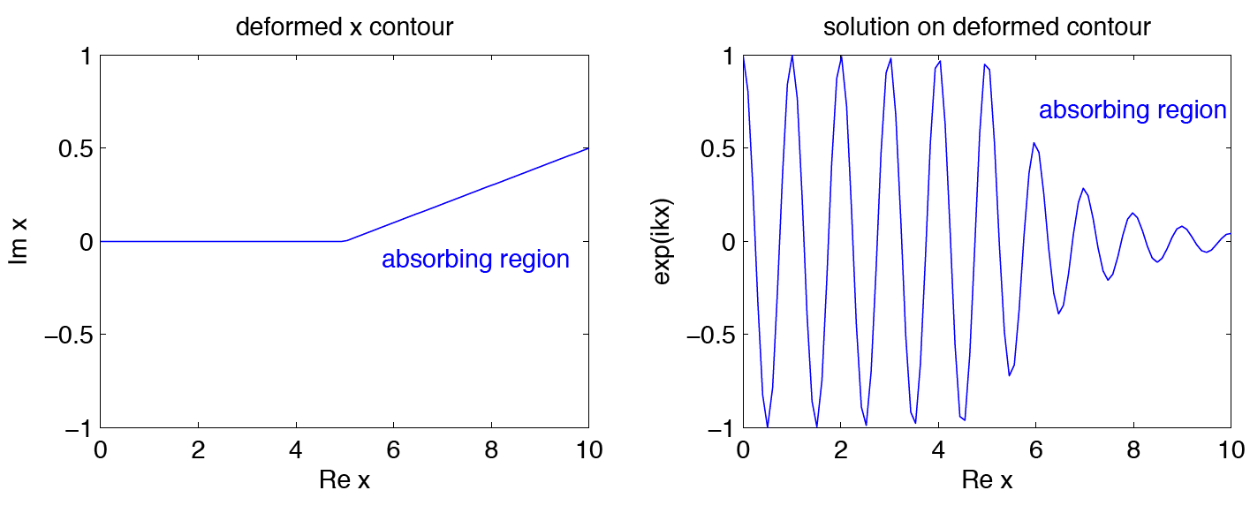
PML step 1: Analytically continue
Electromagnetic fields & equations are analytic in x,
so we can evaluate at complex x & still solve same equations
unchanged
(no reflection)
unchanged
(no reflection)

Slide 45
PML step 2: Coordinate transformation
~
Weird to solve equations for complex coordinates x,
so do coordinate transformation back to real x.
1
2
(allow x-dependent
PML strength σ)
nondispersive materials: k/ω ~ constant
so decay rate independent of ω
(at a given incidence angle)

Slide 46
PML Step 3: Effective materials
In Maxwell’s equations,
coordinate transformations are equivalent to transformed materials
(Ward & Pendry, 1996: “transformational optics”)
x PML Jacobian
for isotropic starting materials:
effective
conductivity
PML = effective anisotropic “absorbing” ε, μ

Slide 47
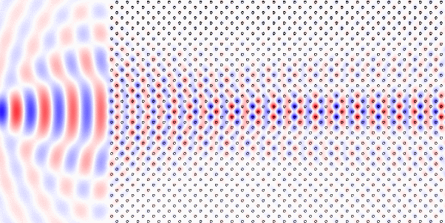
Photonic-crystal PML?
FDTD (Meep) simulation:
?
?
?
?
?
ε not even continuous
in x direction,
much less analytic!
x
Analytic continuation of Maxwell’s equations is hopeless
— no reason to think that PML technique should work

Slide 48
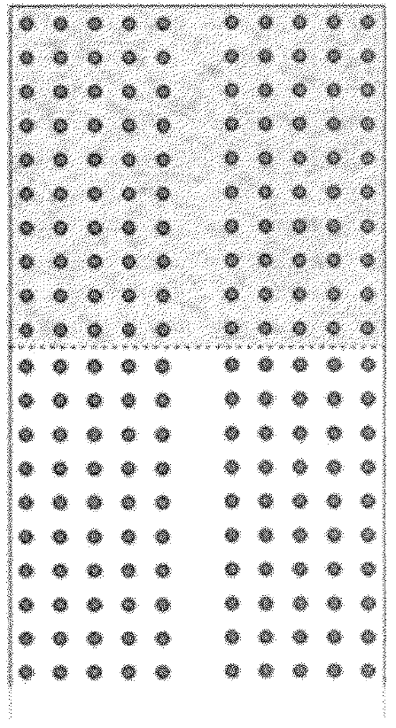
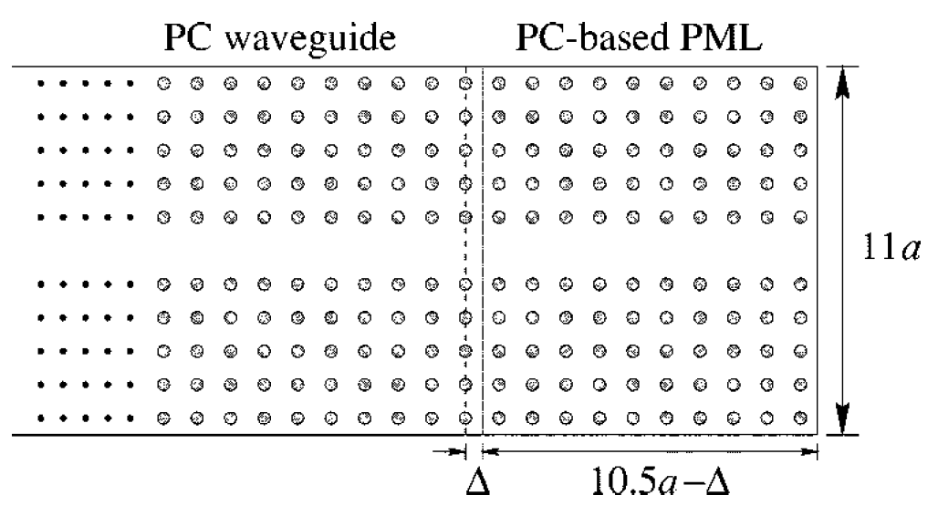
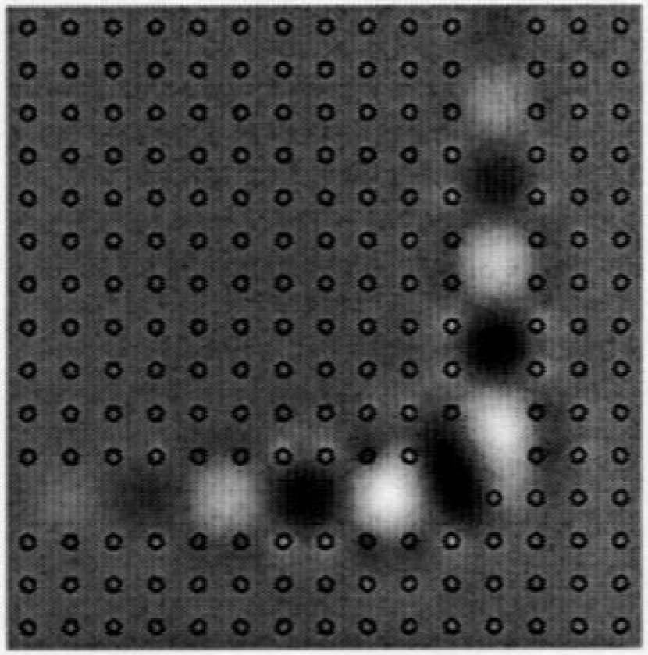
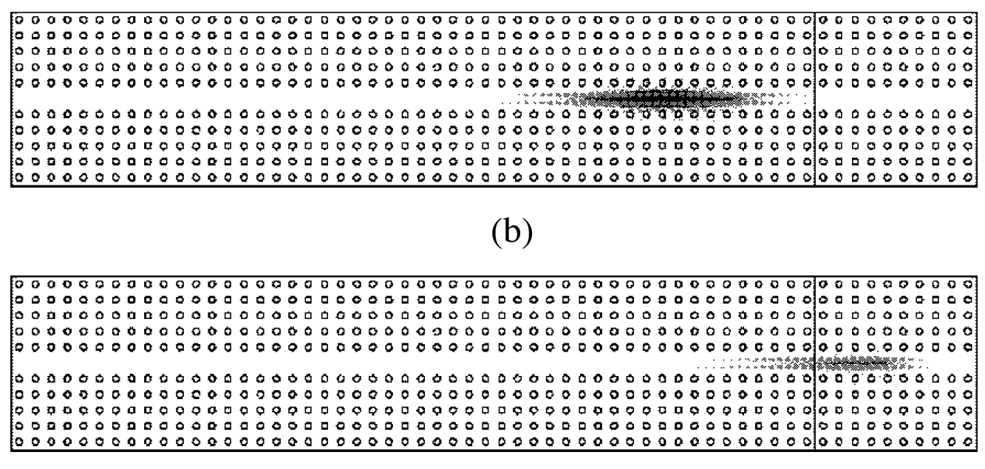
Photonic-crystal PMLs: Magic?
[ Kosmidou et al (2003) ]
[ Koshiba, Tsuji, & Sasaki (2001) ]
PML
… & several other authors …
Low reflections claimed
— is PML working?
Something suspicious:
very thick absorbers.

Slide 49
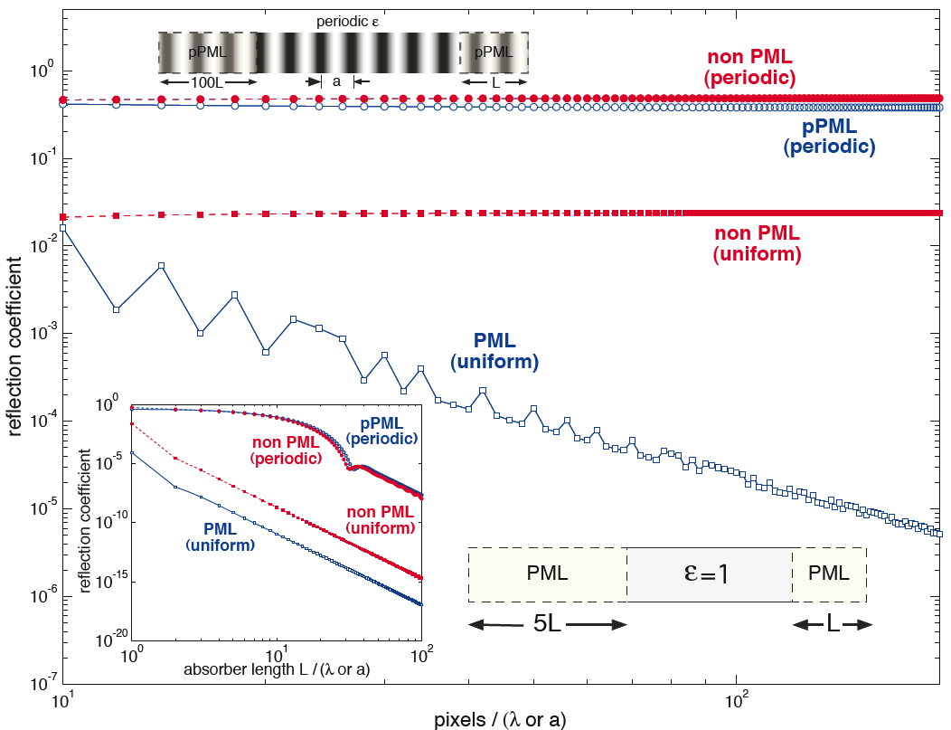
Failure of Photonic-crystal “pseudo-PML”
[ Oskooi et al, Optics Express 16, 11376 (2008) ]
1d test case:
(pseudo-)
PML in
periodic ε
reflection
doesn’t → 0
as ∆x → 0
… similar
to non-PML
scalar σ
in uniform ε=1 medium,
PML reflection → 0
for exact wave equation

Slide 50
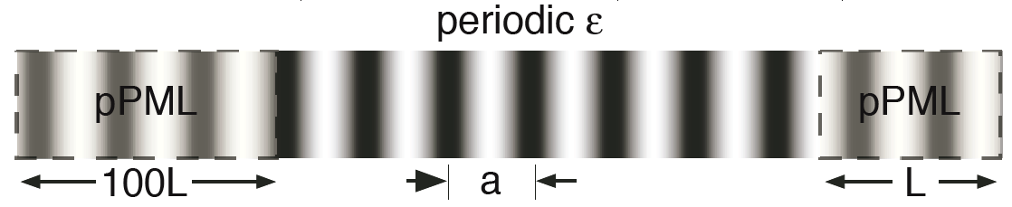
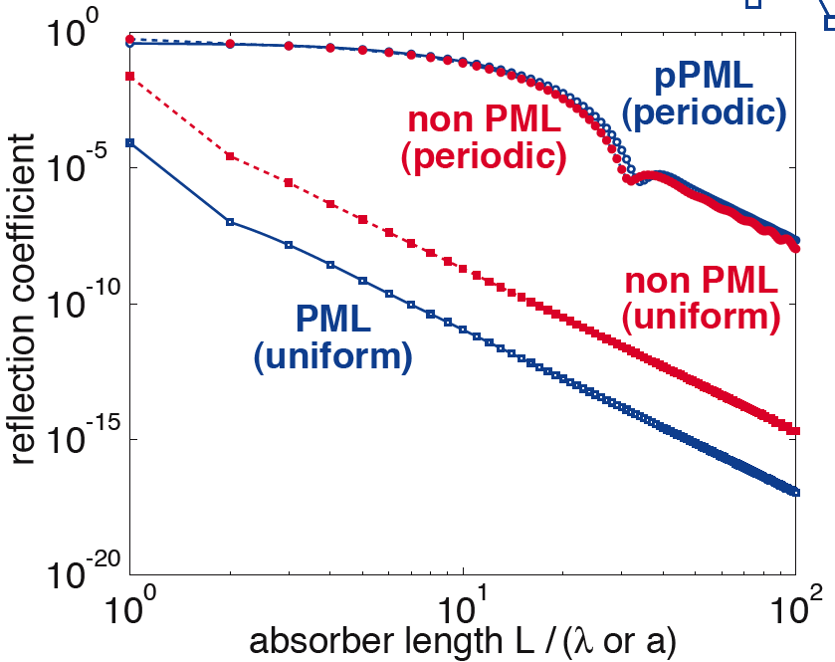
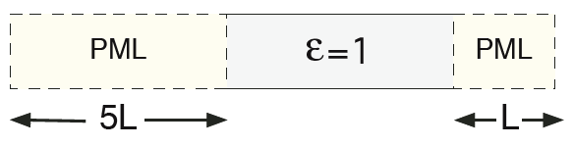
Redemption of the pseudo-PML: slow (“adiabatic”) absorption turn-on
[ Oskooi et al, Optics Express 16, 11376 (2008) ]
Any absorber,
turned on gradually
enough, will have
reflections → 0!
PML (when it works)
just helps coefficient.

Slide 51
What about DtN / RCWA / Bloch-mode-expansion / SIE methods?
— useful, nice methods that can impose outgoing boundary conditions
exactly, once the Green’s function / Bloch modes computed
challenge problem for any method:
periodic 3d dielectric waveguide bend in air
(note: both guided and radiating modes!)
… DtN / Green’s function / Bloch modes (incl. radiation!) expensive

Slide 52
Computational Nanophotonics: Sources & Integral Equations
Steven G. Johnson
MIT Applied Mathematics

Slide 53
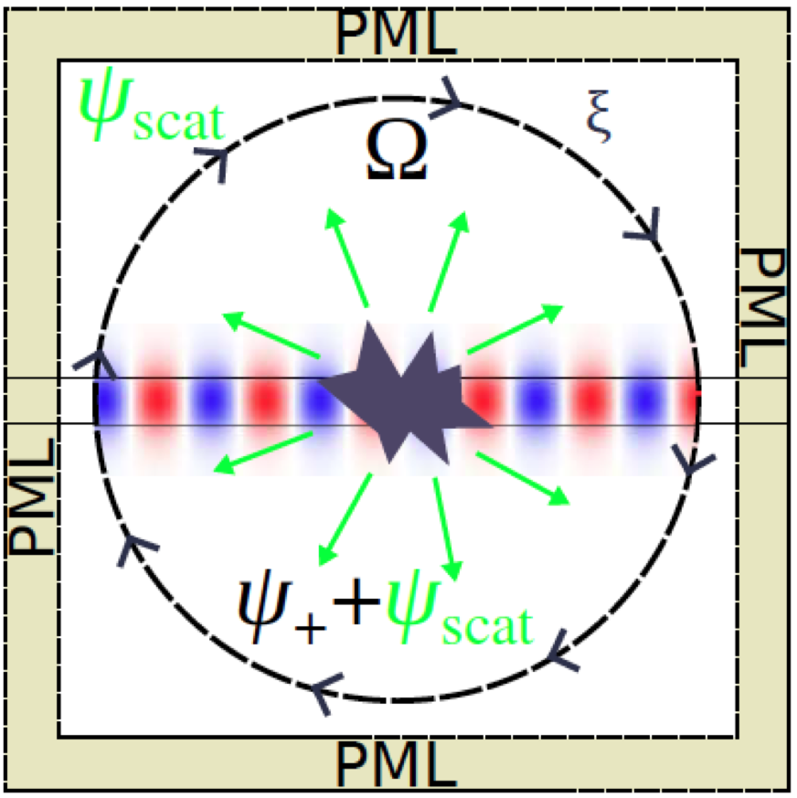
How can we excite a desired incident wave?
Want some current source
to excite incident waveguide
mode, planewave, etc…
— also called transparent
source since waves
do not scatter from it
(thanks to linearity)
— vs. hard source =
Dirichlet field condition
?
?

Slide 54
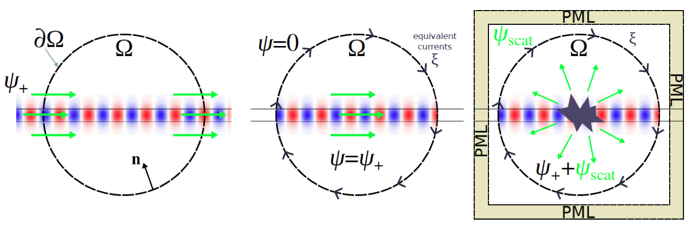
Equivalent currents (“total-field/scattered-field” approach)
[ review article: arXiv:1301.5366 ]
equivalent
currents
c
f⁺
f⁺
f⁺+f–
f–
f=0
known incident fields
in ambient medium
(possibly inhomogeneous,
e.g. waveguide or photonic crystal)
want to construct
surface currents
do simulations
in finite domain
+ inhomogeneities
/ interactions
= scattered field f–
giving same f⁺ in Ω

Slide 55
The Principle of Equivalence in classical EM (or Stratton–Chu equivalence principle) (formalizes Huygens’ Principle) (or total-field/scattered-field, TFSF) (close connection to Schur complement [Kuchment])
[ see e.g. Harrington, Time-Harmonic Electromagnetic Fields ]
[ review article: arXiv:1301.5366 ]

Slide 56
starting point: solution in all space
incident
fields f⁺
medium χ
Ω
6-component
fields:
solve (source-free) Maxwell PDE (in frequency domain):

Slide 57
constructing solution in Ω
equivalent
“6”-component
surface currents
c
Ω
f = 0
f = f⁺
n
construct c so that f is a new solution:
c

Slide 58
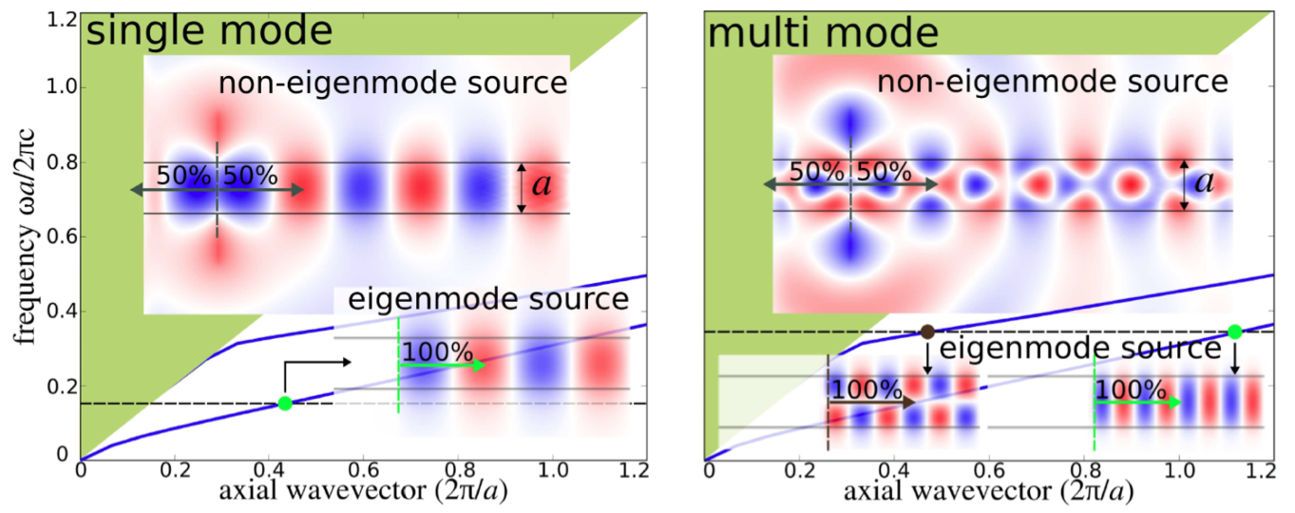
Exciting a waveguide mode in FDTD
— compute mode in MPB, then use as source in MEEP
(constant J)
[ review article: arXiv:1301.5366 ]

Slide 59
Problems with equivalent sources
(if not solved, undesired excitation of other waves)
[ review article: arXiv:1301.5366 ]
• Discretization mismatch: at finite resolution, solutions from
one technique (MPB) don’t exactly match discrete modes
in another technique (Meep) — leads to small imperfections
— solvable by using the same discretization to find modes
• Dispersion: mode profile varies with ω, so injecting a pulse p(t)
requires a convolution with c(x,ω) ↔ c(x,t)
ˆ
Fourier
ˆ
currents(x,t) = p(t) * c(x,t) ≈ p(t) c(x,ω)
time domain only
narrow-bandwidth
– convolutions expensive, can be approximated by
finite-time (FIR/IIR) calculations using DSP techniques
– specialized methods are known for planewave sources
(have numerical dispersion!)

Slide 60
Shortcut: Subtract two simulations
example: 90° bend of single-mode dielectric waveguide
1
1
2
simple
constant-amplitude
line-current J
same J
want incident, transmitted,
and reflected energy-flux spectra:
incident: Poynting flux of f_{straight}
transmitted: flux of f_{bend}
reflected: flux of f_{bend}–f_{straight}
ˆ
2
2
accumulate (discrete-time)
Fourier transforms of fields:
ˆ
2
ˆ
ˆ
1
1
at desired frequencies ω

Slide 61
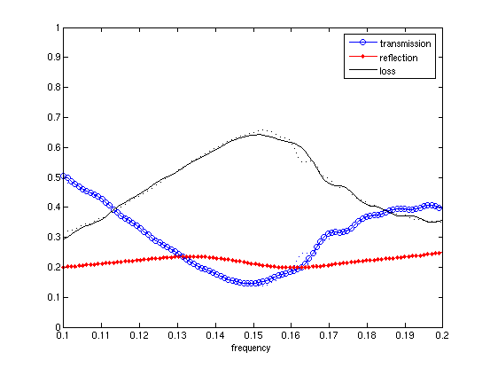


Shortcut: Subtract two simulations
example: 90° bend of single-mode dielectric waveguide
(waveguide width) / λ

Slide 62
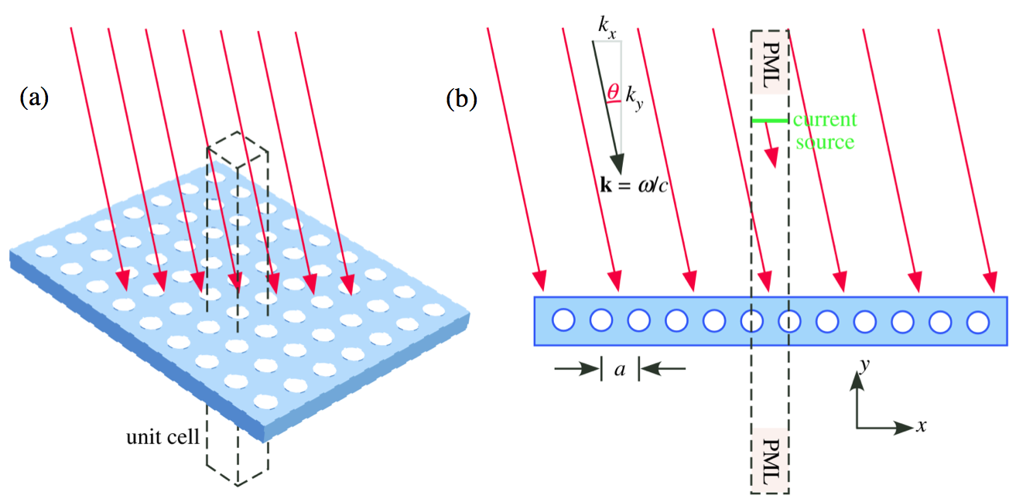
Shortcut: Planewave sources for periodic media
[ review article:
arXiv:1301.5366 ]
Bloch-periodic e^{ikxa}
trick #1: incident & scattered fields
are Bloch-periodic/quasiperiodic
trick #2: e^{ikxx} current source
produces planewave

Slide 63
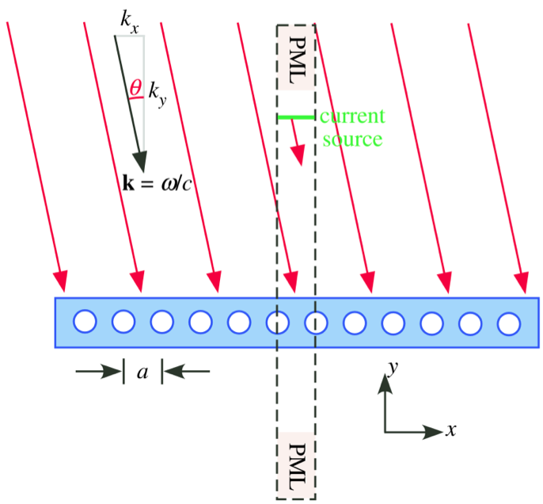
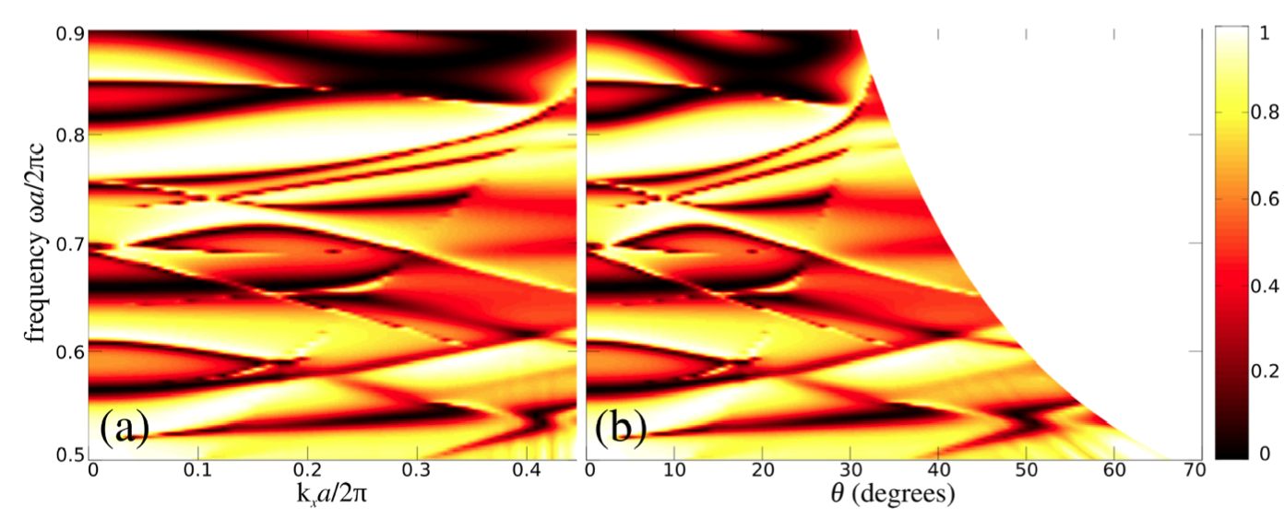
Reflection spectra example for periodic media
(Fano resonance lineshapes)
note: ω all above
light line
(req. for incident planewave)
entire spectrum at fixed k_{x}
from single FDTD simulation
(Fourier transform of pulse)
⟺ curved line
θ = asec(ck_{x}/ω)
in (ω,θ) plot

Slide 64
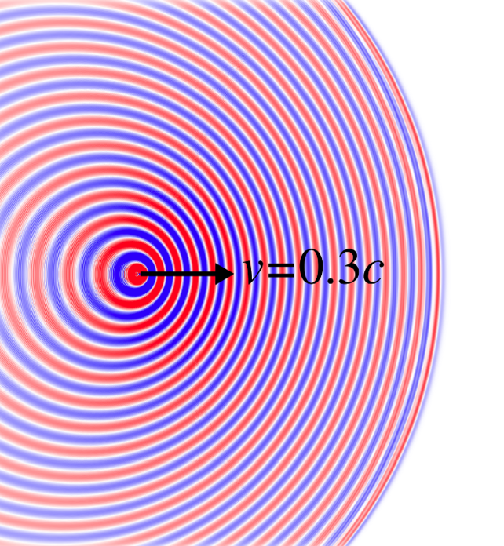
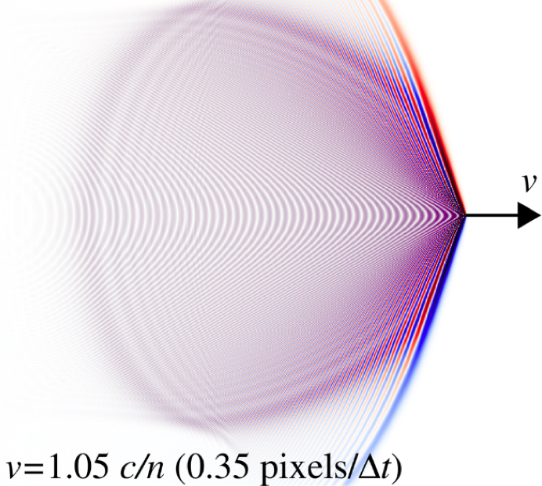
Fun possibilities in FDTD: moving sources [= just some currents J(x,t) ]
Doppler shift from
moving oscillating dipole
Cerenkov radiation from moving
point charge in dielectric medium

Slide 65
Cerenkov radiation
charge density
⇒ current density
x
q
= e^{i(kx–ωt)}
if ω(k)=kv
excites radiating mode ω(k_{x},k_{y})
if v = ω(k_{x},k_{y})/k_{x}
= phase velocity in x direction
≥ c/n in index-n medium

Slide 66
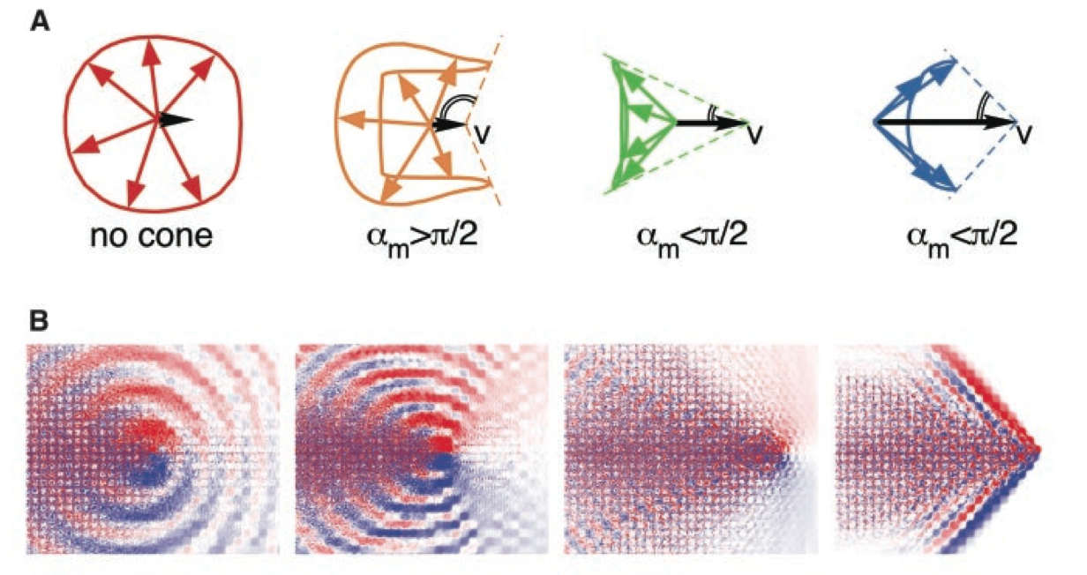
Cerenkov radiation in photonic crystal
excites radiating mode ω(k_{x},k_{y})
if v = ω(k_{x},k_{y})/(k_{x} + 2πm/a)
for any integer m
⇒ no minimum v
[ Smith–Purcell effect ]
v
q
very different radiation
patterns & directions
depending on v,
due to interactions with
2d PhC dispersion curves
[ Luo, Ibanescu, Johnson,
& Joannopoulos (Science, 2002) ]

Slide 67
Surface-integral equations (SIEs) and boundary-element methods (BEMs)
[ see e.g. Harrington, Time-Harmonic Electromagnetic Fields ]
Harrington, “Boundary integral formulations for homogeneous
material bodies,” J. Electromagnetic Waves Appl. 3, 1–15 (1989)
Chew et al., Fast and Efficient Algorithms
in Computational Electromagnetics (2001) ].

Slide 68
Exploiting partial knowledge of Green’s functions
a typical scattering problem:
incident
fields
medium 0
medium 1
scattered
fields
interior
fields
suppose that we know Green’s functions
in infinite medium 0 or medium 1
— known analytically for homogeneous media
— computable by much smaller calculation in periodic medium
Can exploit this to derive integral equation for surface unknowns only.

Slide 69
The Principle of Equivalence in classical EM
[ see e.g. Harrington, Time-Harmonic Electromagnetic Fields ]
incident
fields f⁰⁺
medium 0
medium 1
scattered
fields f^{0–}
interior
fields f¹
6-component
fields:
Maxwell PDE:
… we want to partition
into separate medium 0/1
problems & enforce continuity…

Slide 70
Constructing a medium-0 solution
“equivalent”
6-component
surface currents
c
same incident
fields f⁰⁺
medium 0
medium 0
same
fields f^{0–}
f=0 (!!)
n
modified Maxwell PDE:
c

Slide 71
The Principle of Equivalence I
“equivalent”
6-component
surface currents
c
incident
fields f⁰⁺
medium 0
medium 0
same
scattered
fields f^{0–} of c
f=0 (!!)
convolution with
6x6 Green’s function Γ⁰
of homogenous medium 0
[ e.g. Harrington, Time-Harmonic Electromagnetic Fields ]

Slide 72
The Principle of Equivalence II
opposite-sign
6-component
surface currents
– c
medium 1
f=0
medium 1
convolution with
6x6 Green’s function Γ¹
of homogenous medium 1
[ e.g. Harrington, Time-Harmonic Electromagnetic Fields ]

Slide 73
Surface-Integral Equations (SIE)
unknown
c
medium 0
medium 1
c determined by
continuity of tangential fields
at 0/1 interface:
[ e.g. Harrington, Time-Harmonic Electromagnetic Fields ]

Slide 74
Discretizing the Maxwell SIE
unknown
c
pick some basis b_{n} (n=1,…,N→∞)
for surface-tangential vector fields
N discrete
unknowns x_{n}
⇒ N equations
[ e.g. Harrington, Time-Harmonic Electromagnetic Fields ]

Slide 75
Discretizing the Maxwell SIE
Galerkin method — require error ⊥ basis:
unknown
c
pick some basis b_{n} (n=1,…,N→∞)
for surface-tangential vector fields
N discrete
unknowns x_{n}
⇒ N equations Mx = s
[ e.g. Harrington, Time-Harmonic Electromagnetic Fields ]

Slide 76
Discretized SIE: Two Objects
medium 2
medium 0
medium 1
⇒ linear equations Mx = s
… + straightforward generalizations to more objects,
nested objects, etcetera

Slide 77
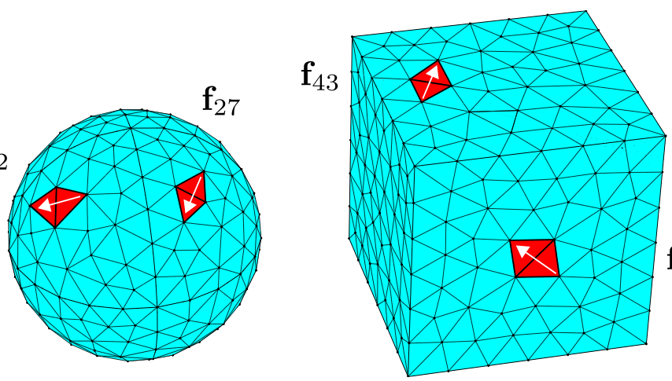
SIE basis choices
• Can use any basis for c = any basis of surface functions
… basis is not incoming/outgoing waves
& need not satisfy any wave equation
• Spectral bases: spherical harmonics, Fourier series, …
… nice for high symmetry
~ uniform spatial resolution
• Boundary Element Methods (BEM):
localized basis functions defined on irregular mesh
“RWG” basis (1982):
vector-valued b_{n} defined
on pairs of adjacent triangles
via degree-1 polynomials

Slide 78
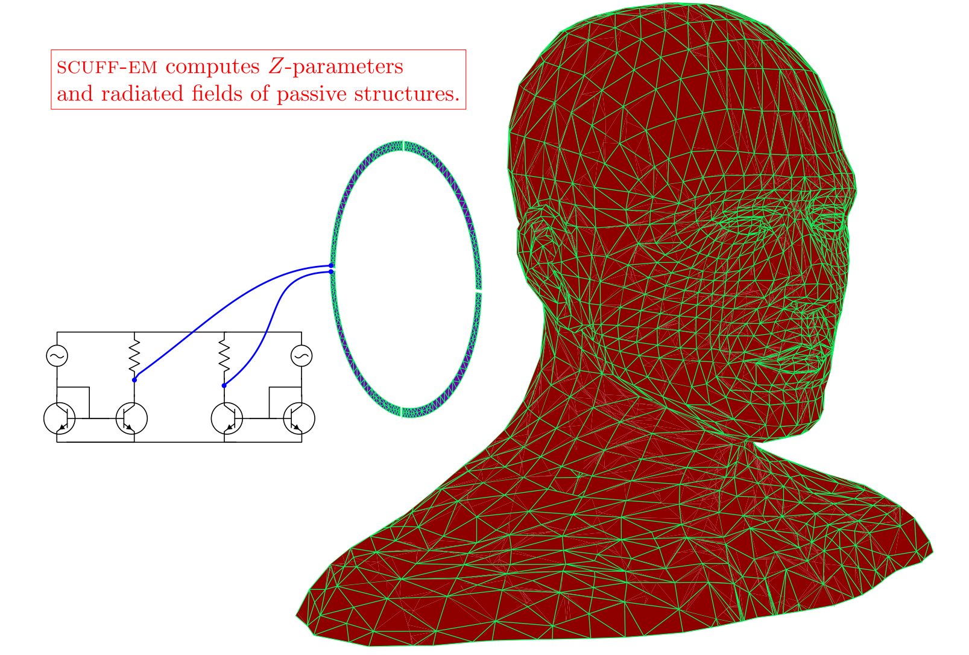
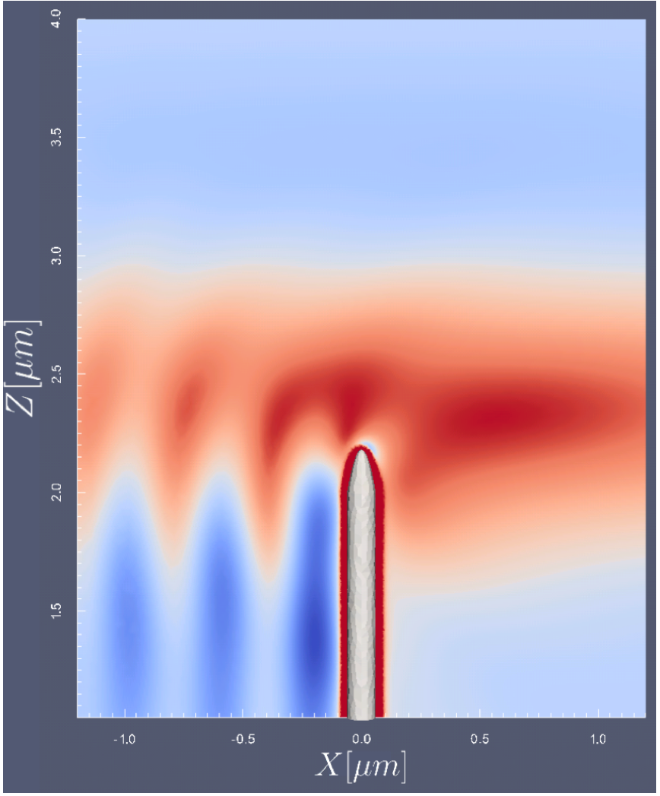
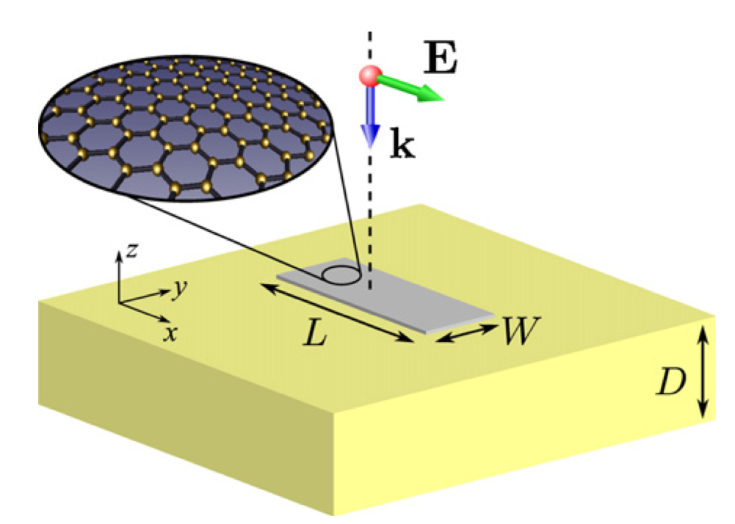
BEM strengths
especially small surface areas in a large (many-λ) volume, e.g.:
complex impedance
of passive structures
surface plasmons (metals):
extremely sub-λ fields
Graphene
~ delta-function
surface conductivity
= jump discontinuity
(~ E) in H field
silver
nanotip
[ Johannes Feist, Harvard ]
[ Llatser et al. (2012) ]

Slide 79
The bad news of BEM
• Not well-suited for nonlinear, time-varying, or
non-piecewise-constant media
• BEM system matrix
— singular integrals for overlapping b_{m}, b_{n}
…special numerical integration techniques
— M is not sparse, but:
often small enough for dense solvers (≲ 10⁴×10⁴)
+ “fast solvers:” approximate sparse factorizations
(fast multipole method, etc.)
— lots of work every time you change Γ
(e.g. 3d vs. 2d, periodic boundaries, anisotropic, …)
… but independent of geometry

Slide 80
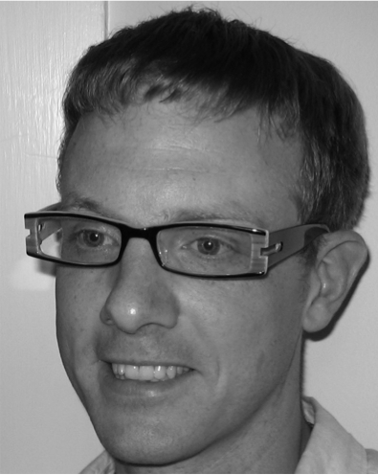
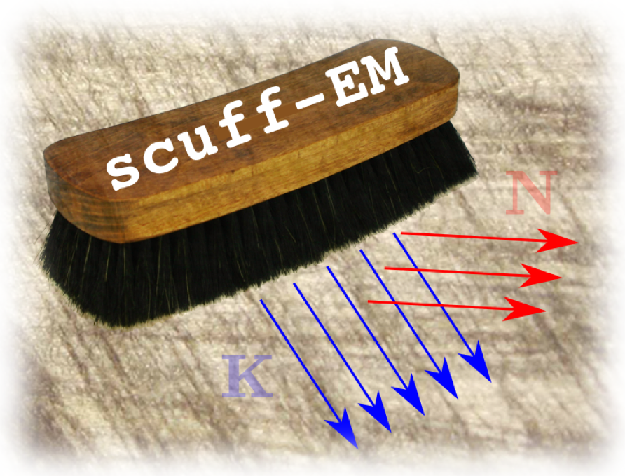
The good news of BEM: You don’t have to write it yourself
Free software developed by Dr. Homer Reid
(collaboration with Prof. Jacob White @ MIT)
SCUFF-EM
[ http://homerreid.ath.cx/scuff-EM ]

Slide 81
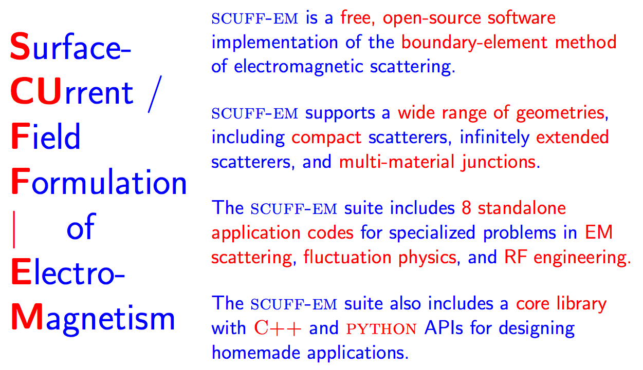
http://homerreid.com/scuff-EM
* to be released by end of October-ish

Slide 82

SCUFF usage outline

Slide 83

Geometries in SCUFF

Slide 84

Geometries in SCUFF
(discretization of SIE at junctions of 3+ materials is a bit tricky)

Slide 85

Periodic geometries in SCUFF
(implementing periodicity is nontrivial: changes Green’s function!
SCUFF: periodic Γ = Σ(nearest neighbors) + Ewald summation)

Slide 86
Using SIE/BEM solutions
Solving the SIE gives the surface currents c, and
from these (via Γ*c) one can obtain any desired fields, but…
It is much more efficient to compute as much as possible
directly from c (~ n × surface fields). Examples:
• Scattering matrices (e.g. spherical-harmonic waves in → out):
obtain directly from multipole moments of “currents”
• Any bilinear function of the surface fields can be computed
directly from bilinear functions of c:
— scattered/absorbed power, force, torque, …
• Net effects of quantum/thermal fluctuations in matter can
be computed from norm/det/trace of M or M^{–1}:
— thermal radiation, Casimir (van der Waals) forces, …

Slide 87
Resonant modes (and eigenvalues)
• BEM scattering problems are of the form M(ω)x = s.
Resonances (and eigenvalues) are ω where this system
is singular, i.e. the nonlinear eigenproblem
det M(ω) = 0
For passive (⇒causal) systems, solutions can only occur
for Im ω ≤ 0.
• Various algorithms exist, including an intriguing algorithm
using contour integrals of M(ω) [ Beyn (2012) ].

Slide 88
to be continued…
Further reading:
Free FDTD software: http://jdj.mit.edu/meep
Free BEM software:
http://homerreid.ath.cx/scuff-EM/
Review on wave sources:
arXiv:1301.5366 [ in Taflove, Oskooi, & Johnson, eds.,
Advances in FDTD Comput. EM (2013) ]

Slide 89
Computational Nanophotonics: Optimization and “Inverse Design”
Steven G. Johnson
MIT Applied Mathematics

Slide 90
Many, many papers that parameterize by a few degrees of freedom and optimize… Today, focus is on large-scale optimization, also called inverse design: so many degrees of freedom (10²–10⁶) that computer is “discovering” new designs.

Slide 91
Outline
• Brief overview/examples of
large-scale optimization work in photonics
• Overview of optimization terminology,
problem types, and techniques.
• Some more detailed photonics examples.

Slide 92
Outline
• Brief overview/examples of
large-scale optimization work in photonics
• Overview of optimization terminology,
problem types, and techniques.
• Some more detailed photonics examples.

Slide 93


Topology optimization
A
Given two (or more) materials
A and B, determine what arrangement
— including what topology —
optimizes some objective/constraints.
B
B
Continuous relaxation:
allow material to vary in [A,B]
continously at every point
• Not uncommon for optimum to
yield A or B almost everywhere
• Possible to add “penalty” to
objective for intermediate values

Slide 94
Discretizing Topology Optimization
for computer, need finite-dimensional parameter space
some computational grid
Level-set method: value of
“level-set” function φ(x) varies
continuously at each pixel
⇒ material A or B if φ > 0 or < 0
…or…
Continuous relaxation: material
varies in [A,B] at each pixel
e.g. in electromagnetism, let ε at each
pixel vary in [A,B].

Slide 95





Dobson et al. (Texas A&M)
(maximizes ~∆ω,
not fractional gap!)
(square lattices only)
TM gap, bands 3 & 4
TM bands 6 & 7
SIAM J. Appl. Math. 59, 2108 (1999)
optimized TE gaps
square lattice
thousands of iterations
& still not optimal!
optimize TM localization in supercell
SIAM J. Appl. Math 64, 762 (2004)
J. Comput. Phys 158,
214 (2000)

Slide 96





2d (TE or TM) transmission optimization Sigmund, Jensen, Pederson et al. [ www.topopt.dtu.dk ]
crossings (2d TE) Elec. Lett. 42, 1031 (2006)
bend optimization
T-junctions
JOSA B 22, 1191 (2005)
low-index
(scalar approx.)
dispersion-
compensating fibers
JOSA B 25, 88 (2008)
Opt. Express 12, 1996 (2004)
OE 12, 5916 (2004)

Slide 97


Dispersion optimization Sigmund, Jensen, Pederson et al. [ www.topopt.dtu.dk ]
low-index
(scalar approx.)
dispersion-
compensating fibers
JOSA B 25, 88 (2008)
optimized 2d scalar
phononic crystals
[ Phil. Trans. Roy. Soc.
London A 361, 1001 (2003) ]
constant group-velocity
band in 2d TE line-defect
optimized
phononic gap ∆ω
bands 1 & 2
… also band gaps for 2d (scalar) phononic crystals…

Slide 98


Kao, Osher, and Yablonovitch 2d TM and TE square-lattice gaps via level sets
Appl. Phys. B 81, 235 (2005)
TM gap,
bands 6 & 7
(maximizes ∆ω,
not fractional gap!)
TE gap,
bands 5 & 6

Slide 99





Frei et al. (UIUC)
optimizing 3d Q
J. Appl. Phys 103, 033102 (2008)
(level-set + MMA)
via topology optimization
APL 86, 111114 (2005)
2d TM “directional” emission
via level-set method
Frei, Opt. Lett. 32, 77 (2007)

Slide 100



Other Topology Optimizers
“2d” (really 1d) TE filter
Byun, IEEE Trans. Magnetics 43, 1573 (2007)
2d TM bend
[ Tsuji, Phot. Tech. Lett. 20, 982 (2008) ]
2d TM gap (∆ω)
bands 3 & 4
He et al.,
J. Comput. Phys. 225, 891 (2007)

Slide 101


Optimization with many discrete degrees of freedom
2d TM “bender”
moving cylinders around (steepest-descent)
[ Seliger, J. Appl. Phys. 100, 034310 (2006) ]
2d TM “lens” design
genetic algorithms: moving cylinders around
[ Håkansson, IEEE J. Sel. Ar. Commun. 23, 1365 (2005)

Slide 102
Outline
• Brief overview/examples of
large-scale optimization work in photonics
• Overview of optimization terminology,
problem types, and techniques.
• Some more detailed photonics examples.

Slide 103
A general optimization problem
minimize an objective function f₀
with respect to n design parameters x
(also called decision parameters, optimization variables, etc.)
— note that maximizing g(x)
corresponds to f₀ (x) = –g(x)
subject to m constraints
note that an equality constraint
h(x) = 0
yields two inequality constraints
f_{i}(x) = h(x) and f_{i+1}(x) = –h(x)
(although, in practical algorithms, equality constraints typically require special handling)
x is a feasible point if it
satisfies all the constraints
feasible region = set of all feasible x

Slide 104
Important considerations
Global versus local optimization
Convex vs. non-convex optimization
Unconstrained or box-constrained optimization, and other special-case constraints
Special classes of functions (linear, etc.)
Differentiable vs. non-differentiable functions
Gradient-based vs. derivative-free algorithms
…
Zillions of different algorithms, usually restricted to various special cases, each with strengths/weaknesses

Slide 105
Global vs. Local Optimization
For general nonlinear functions, most algorithms only guarantee a local optimum
that is, a feasible x_{o} such that f₀(x_{o}) ≤ f₀(x) for all feasible x within some neighborhood ||x–x_{o}|| < R (for some small R)
A much harder problem is to find a global optimum: the minimum of f₀ for all feasible x
exponentially increasing difficulty with increasing n, practically impossible to guarantee that you have found global minimum without knowing some special property of f₀
many available algorithms, problem-dependent efficiencies
not just genetic algorithms or simulated annealing (which are popular, easy to implement, and thought-provoking, but usually very slow!)
for example, non-random systematic search algorithms (e.g. DIRECT), partially randomized searches (e.g. CRS2), repeated local searches from different starting points (“multistart” algorithms, e.g. MLSL), …

Slide 106
Convex Optimization
[ good reference: Convex Optimization by Boyd and Vandenberghe,
free online at www.stanford.edu/~boyd/cvxbook ]
All the functions f_{i} (i=0…m) are convex:
where
convex:
f(x)
not convex:
f(x)
αf(x) + βf(y)
f(αx+βy)
x
y
x
y
For a convex problem (convex objective & constraints)
any local optimum must be a global optimum
⇒ efficient, robust solution methods available

Slide 107
Important Convex Problems
LP (linear programming): the objective and constraints are affine: f_{i}(x) = a_{i}^{T}x + α_{i}
QP (quadratic programming): affine constraints + convexquadratic objective x^{T}Ax+b^{T}x
SOCP (second-order cone program): LP + cone constraints ||Ax+b||₂ ≤ a^{T}x + α
SDP (semidefinite programming): constraints are that ΣA_{k}x_{k} is positive-semidefinite
all of these have very efficient, specialized solution methods

Slide 108
Non-convex local optimization: a typical generic outline
[ many, many variations in details !!! ]
1
At current x, construct approximate model of f_{i}
—e.g. affine, quadratic, … often convex
2
Optimize the model problem ⇒ new x
— use a trust region to prevent large steps
3
Evaluate new x:
— if “acceptable,” go to 1
— if bad step (or bad model), update
trust region / model and go to 2

Slide 109
Important special constraints
Simplest case is the unconstrained optimization problem: m=0
e.g., line-search methods like steepest-descent, nonlinear conjugate gradients, Newton methods …
Next-simplest are box constraints (also called bound constraints): x_{k}^{min} ≤ x_{k} ≤ x_{k}^{max}
easily incorporated into line-search methods and many other algorithms
many algorithms/software only handle box constraints
…
Linear equality constraints Ax=b
for example, can be explicitly eliminated from the problem by writing x=Ny+ξ, where ξ is a solution to Aξ=b and N is a basis for the nullspace of A

Slide 110
Derivatives of f_{i}
Most-efficient algorithms typically require user to supply the gradients ∇_{x}f_{i} of objective/constraints
you should always compute these analytically
rather than use finite-difference approximations, better to just use a derivative-free optimization algorithm
in principle, one can always compute ∇_{x}f_{i} with about the same cost as f_{i}, using adjoint methods
gradient-based methods can find (local) optima of problems with millions of design parameters
Derivative-free methods: only require f_{i} values
easier to use, can work with complicated “black-box” functions where computing gradients is inconvenient
may be only possibility for nondifferentiable problems
need > n function evaluations, bad for large n

Slide 111
Removable non-differentiability
consider the non-differentiable unconstrained problem:
f₀(x)
–f₀(x)
optimum
equivalent to minimax problem:
x
…still nondifferentiable…
…equivalent to constrained problem with a “temporary” variable t:
differentiable!
subject to:

Slide 112
Example: Chebyshev linear fitting
fit line
ax₁+x₂
b
find the fit that minimizes
the maximum error:
N points
(a_{i},b_{i})
… nondifferentiable minimax problem
a
equivalent to a linear programming problem (LP):
subject to 2N constraints:

Slide 113
Gap Optimization via nonlinear constraints
we want:
not differentiable at accidental degeneracies
an equivalent problem:
…with
(mostly) differentiable
nonlinear constraints:

Slide 114


Optimizing 1st TM and TE gaps for a triangular lattice with 6-fold symmetry (between bands 1 & 2)
48.3% TM gap (ε = 12:1)
51.4% TE gap (ε = 12:1)
30 iterations of optimizer

Slide 115


Optimizing 1st complete (TE+TM) 2d gap
20.7% gap (ε = 12:1)
21.1% gap (ε = 12:1)

Slide 116



+ some local minima
–0.5% gap
–10% gap
–2% gap
good news: only a handful of minima (in 10³-dimensional space!)

Slide 117
Relaxations of Integer Programming
If x is integer-valued rather than real-valued (e.g. x ∈ {0,1}^{n}),
the resulting integer programming or combinatorial optimization
problem becomes much harder in general (often NP-complete).
However, useful results can often be obtained by a continuous
relaxation of the problem — e.g., going from x ∈ {0,1}^{n} to x ∈ [0,1]^{n}
… at the very least, this gives an lower bound on the optimum f₀
… and penalty methods (e.g. SIMP) can be used to gradually
eliminate intermediate x values.

Slide 118

Early Topology Optimization
design a structure to do something, made of material A or B…
let every pixel of discretized structure vary continuously from A to B
density of each pixel
varies continuously from 0 (air) to max
force
ex: design a cantilever
to support maximum weight
with a fixed amount of material
optimized structure,
deformed under load
[ Buhl et al, Struct. Multidisc. Optim. 19, 93–104 (2000) ]

Slide 119
Some Sources of Software
• Decision tree for optimization software:
http://plato.asu.edu/guide.html
— lists many packages for many problems
• CVX: general convex-optimization package
http://www.stanford.edu/~boyd/cvx
• NLopt: implements many nonlinear optimization algorithms
(global/local, constrained/unconstrained, derivative/no-derivative)
http://ab-initio.mit.edu/nlopt

Slide 120
Outline
• Brief overview/examples of
large-scale optimization work in photonics
• Overview of optimization terminology,
problem types, and techniques.
• Some more detailed photonics examples.

Slide 121
Key questions occur before choosing optimization algorithm:
• How to parameterize the degrees of freedom
— how much knowledge of solution to build in?
• Which objective function & constraints?
— many choices for a given design goal,
… can make an enormous difference in the
computational feasibility
& the robustness of the result.

Slide 122
Today: Three Examples
• Optimizing photonics without solving Maxwell’s equations
— transformational inverse design
• Ensuring manufacturability of narrow-band devices
— robust optimization in photonics design
• Optimizing eigenvalues without eigensolvers
— microcavity design and the
frequency-averaged local density of states

Slide 123
Today: Three Examples
• Optimizing photonics without solving Maxwell’s equations
— transformational inverse design
• Ensuring manufacturability of narrow-band devices
— robust optimization in photonics design
• Optimizing eigenvalues without eigensolvers
— microcavity design and the
frequency-averaged local density of states
[ X. Liang et al., manuscript in preparation ]

Slide 124





3d Microcavity Design Problem
radiation loss
(finite Q_{rad})
Want some 2d pattern
that will confine light in 3d
with maximal lifetime (“Q_{rad}”)
and minimal modal volume (“V”)
???
planar (2d) pattern
etched in 3d slab
???
V
[ Loncar, 2002 ]
Many ad hoc designs,
trading off Q_{rad} and V…
(“defects”
in periodic
structures)
ring resonators
[ Song, (2005) ]
[ Akahane, 2003 ]

Slide 125


Topology optimization? Mostly 2d…
[ Kao and Santosa, 2008 ]
in-plane Q, no V
Vuckovic (2011): ~ min V
2d heuristic for the radiation loss
Can we formulate a practical approach to solve the full problem,
computing the true 3d radiation loss?
Goals: understand ultimate limits on cavity performance,
& eventually push cavity design into new regimes

Slide 126
Not just maximizing Q or Q/V!
Typical figure of merit is “Purcell factor” Q/V
(~ enhancement of light-matter coupling)
Naively, should we maximize Q/V?
R
Trivial design problem: maximum Q/V = ∞
[ e.g. perfect ring resonator of ∞ radius ]
V ~ R
Q_{rad} ~ exp(# R)
Real design problem:
maximize Q
such that V ≤ V₀
minimize V
such that Q ≥ Q₀
or
set by bandwidth, loss tolerance,
& fabrication capabilities

Slide 127
Transforming the problem…
a series of nonobvious transformations makes the problem much easier
minimize modal volume V
subject to Q ≥ Q₀
turn difficult eigenproblem
into easier scattering problem:
Q/V is really just LDOS
Maximize mean LDOS (local density of states)
(= power of dipole)
over bandwidth ω₀/Q₀
complex analysis:
contour integration
+ causality
Maximize LDOS at complex ω=ω₀(1+i/2Q₀)
technical issue:
avoid optimizing along
“narrow ridge”
(avoid ill-conditioned Hessian)
Minimize 1/LDOS at ω₀(1+i/2Q₀)

Slide 128






LDOS: Local Density of States
[ review: arXiv:1301.5366 ]
Maxwell eigenproblem:
Maxwell vector-Helmholtz:
Power radiated by a current J (Poynting’s theorem)
special case of a dipole source: LDOS

Slide 129







Why a “density of states”
consider a
finite domain
(periodic/Dirichlet)
[ review: arXiv:1301.5366 ]
+ small absorption
P =
countable eigenfunctions
E^{(n)} and frequencies ω^{(n)}
+ iγ^{(n)}
loss → 0: a localized measure of spectral density

Slide 130
Now, a few results…
Minimize 1/LDOS at ω₀(1+i/2Q₀)
…Let every pixel be a degree of freedom (ε in [1,12])
~ 10⁵ degrees of freedom
…Solve with (mostly) standard methods:
FDFD solver (sparse-direct + GMRES)
adjoint sensitivity analysis
quasi-Newton optimization (L-BFGS)

Slide 131

2d test case: Out-of-plane J, starting from vacuum initial guess
~10⁵ pixels
can vary
ε in [1,12]
finds
“Bragg onion”
structure
(No Q vs. V
tradeoff)
degrees
of freedom
PML absorbing boundaries

Slide 132

2d test case: Out-of-plane J, starting from PhC initial guess
starting guess
has PhC resonant
mode already,
but optimization
converts back
to Bragg onion

Slide 133

2d test case: In-plane J (breaks symmetry), starting from vacuum initial guess
in-plane J

Slide 134


Maximizing LDOS for random in-plane J = max[LDOS(ω,J_{x})+LDOS(ω,J_{x})]/2
in-plane J
J_{y}
J_{x}
4 out of 10
6 out of 10
Spontaneous symmetry breaking! “Picks” one polarization randomly

Slide 135
3d results: Photonic-crystal slab
Optimize with Q₀=10⁴
i.e. prefer Q ≥ 10⁴ but
after that mainly
minimize V
Next: 2d pattern in 3d slab
(including radiation loss via
PML absorbing boundaries)

Slide 136


3d Slab Results
Q ~ 30,000, V ~ 0.06(λ/n)³
2d pattern in 3d slab
vs. hand-optimized:
Q ~ 100,000, V ~ 0.7(λ/n)³
Q ~ 300,000, V ~ 0.2(λ/n)³
and others…
after deleting “hairs”:
Q ~ 10,000
(without re-optimizing)

Slide 137
Today: Three Examples
• Optimizing photonics without solving Maxwell’s equations
— transformational inverse design
• Ensuring manufacturability of narrow-band devices
— robust optimization in photonics design
• Optimizing eigenvalues without eigensolvers
— microcavity design and the
frequency-averaged local density of states
[ Oskooi et al., Optics Express 20, 21558 (2012). ]
[ Mutapcic et al., Engineering Optim. (2009) ]

Slide 138
Robustness of optimized designs
a “nominal” optimization problem:
minimize
design parameters p
objective(p)

Slide 139
Robustness of optimized designs
a “nominal” optimization problem:
minimize
design parameters p
objective(p,0)
Problem: real objective is inexact, due to uncertainties
in modeling, fabrication, materials, etcetera
… is a function objective(p,u) of p
and unknown/uncertain parameters u ∊ U
Problem: optimization sometimes finds solutions
that are “delicate” and destroyed by uncertainty
… i.e. objective(p, actual u) >> objective(p,0)
… can easily happen in single-frequency wave-optics designs
where optimization finds a delicate interference effect…

Slide 140


Slow light
Any periodic waveguide has a band edge where group velocity → 0
slow
light
Enhances light-matter interactions, dispersion phenomena, tunable time delays
… but hard to couple to ordinary waveguide: large “impedance mismatch”

Slide 141
A slow-light optimization problem
[ Povinelli, Johnson, Joannopoulos (2005) ]
[ Mutapcic, Boyd, Farjadpour, Johnson, Avniel (2009) ]
[ Oskooi et al., Optics Express 20, 21558 (2012). ]
going from uniform waveguide … to periodic waveguide
z
parameter s = 0
or
or
s=1
or…
parameter s = 1
(e.g. s ~ flange width,
hole radius,
block width, …)
design
s(z)
…100s of parameters…
s=0
z=0
z=L
nominal problem:
Find s(z) minimizing loss...

Slide 142

A nominal optimum
finds a
delicate interference
cancellation giving
reflection < 10^{–6}
any tiny
manufacturing defect
will kill this cancellation
(stretching design taper — a simple perturbation)

Slide 143

The solution: Robust optimization
(worst-case minimax)
[ Mutapcic, Boyd, Farjadpour, Johnson, Avniel (2009) ]
• Minimize worst-case
reflection:
min max R(s, u)
• Robust design still
works when random
disorder introduced:
brute-force results =
40× better than
nominal optimum
with surface roughness
s
u
(manufacturing
variation)

Slide 144

A more realistic, slow-light structure
[ Oskooi et al., Optics Express 20, 21558 (2012). ]
robust design, to scale
Slow-light waveguide for TE (in-plane polarization), tapers contain no narrow gaps,
corresponds to contiguous, low-aspect ratio structure in 3d.
… Operate close to band edge, group velocity c/34.
In the presence of disorder,
robust is orders of magnitude
better than nominal optimum.
Nominal optimum is worthless:
reflections > 10%.
Making taper too long makes
things worse: disorder kills you.
(different design for each length)

Slide 145
Today: Three Examples
• Optimizing photonics without solving Maxwell’s equations
— transformational inverse design
• Ensuring manufacturability of narrow-band devices
— robust optimization in photonics design
• Optimizing eigenvalues without eigensolvers
— microcavity design and the
frequency-averaged local density of states
[ Gabrielli, Liu, Johnson & Lipson, Nature Commun. (2012) ]
[ Liu et al., manuscript in preparation. ]

Slide 146


Gradient-index Multimode Optics
Lipson group @ Cornell
can make smoothly varying “gradient-index” structures by grayscale lithography
(variable-thickness waveguide = gradient effective index)
Transformation optics:
design materials that mathematically
mimic coordinate transformations

Slide 147

Transformational Optics
[ Ward & Pendry (1996) ]
Pro: exact transformation of Maxwell solutions, so no reflections or scattering
• transforms all modes same way, preserving relative phase → multimode optics
Cons: most transformations give difficult-to-achieve ε, μ:
• anisotropy; μ ≠ μ₀,
… “round” to isotropic index
• n may be too big / small
Idea: warping light with x'(x)
'
= material transformations
(J = Jacobian matrix)

Slide 148


Transformational Inverse Design
Given a transformation x'(x), we can evaluate its manufacturability
(need minimal anisotropy, attainable indices)
quickly, without solving Maxwell’s equations
… so optimization can rapidly search many transformations
to find the “best” manufacturable design
effective index
want small
radius R
“mode squeezer”
multimode bend

Slide 149

Technical outline
For a given radius R, minimize the maximum anisotropy,
subject to index constraints, over “all” transformations x'(x):
subject to: 1.6 ≤ n(x) ≤ 3.2 t ≥ anisotropy(x) (= “Distortion”–1)
at all x
~ 30,000
constraints
(100×100 x grid)
–1 + tr J^{T}J / 2 det J ≥ 0
(J = Jacobian)
where smooth transformations x'(x) are parameterized by
exponentially convergent Chebyshev/sine series
~ 100
parameters
… so cheap that almost any (local) optimization algorithm is okay …
[ use COBYLA derivative-free sequential LP algorithm of Powell (1994) ]

Slide 150






An optimized multimode bend
optimized index profile
FEM simulation
effective index
input
[ arXiv:1304.1553 ]

Slide 151

Experimental (Si/SiO₂) Realization
[ Gabrielli, Liu, Johnson & Lipson, Nature Commun. (2012) ]
10μm
measured
14dB
reduction
in loss
(conversion)
of the
fundamental
mode
(λ=1.55μm)
vs.
circular bend
(80μm bend radius)

